Slide 1
COSP230 Ch. 3
User Input, Variables, and Operations

Slide 2
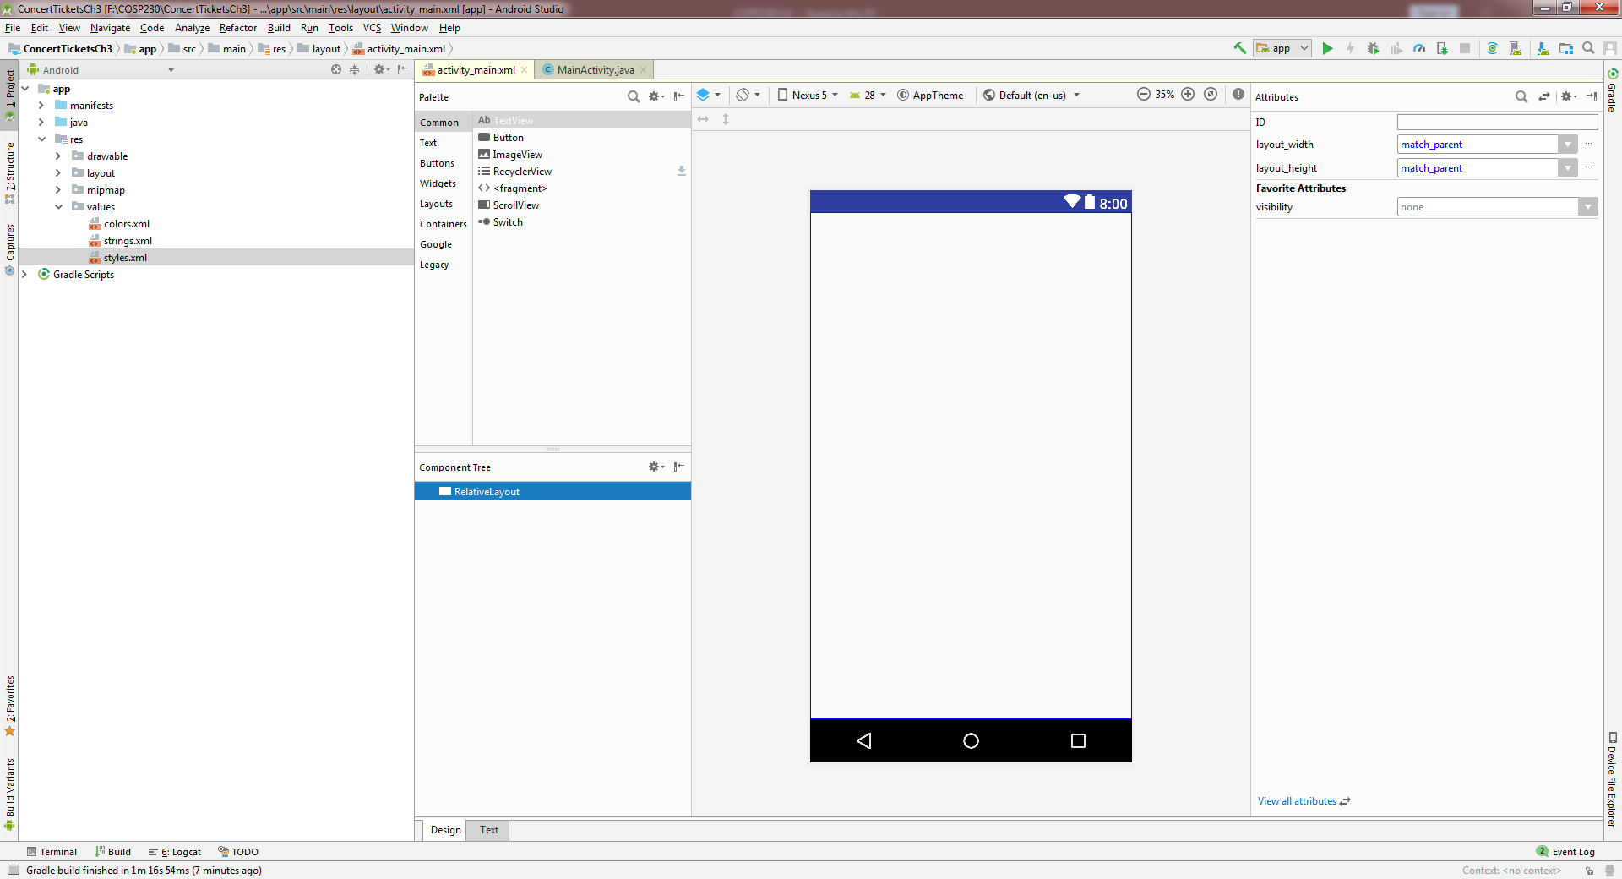
Start of Project (Delete HelloWorld text):

Slide 3
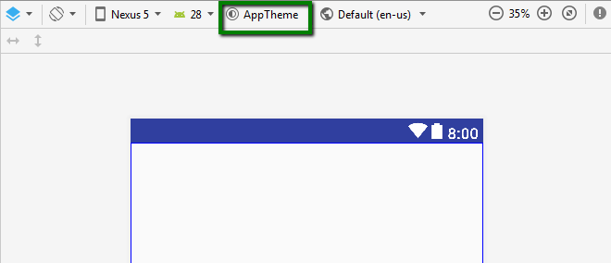
Themes
Can be applied to a single Activity or an entire app
Specifies visual properties, such as
Color
Height
Padding
Font size
Some change background wallpaper
Some hide title bar
Some display action bar

Slide 4
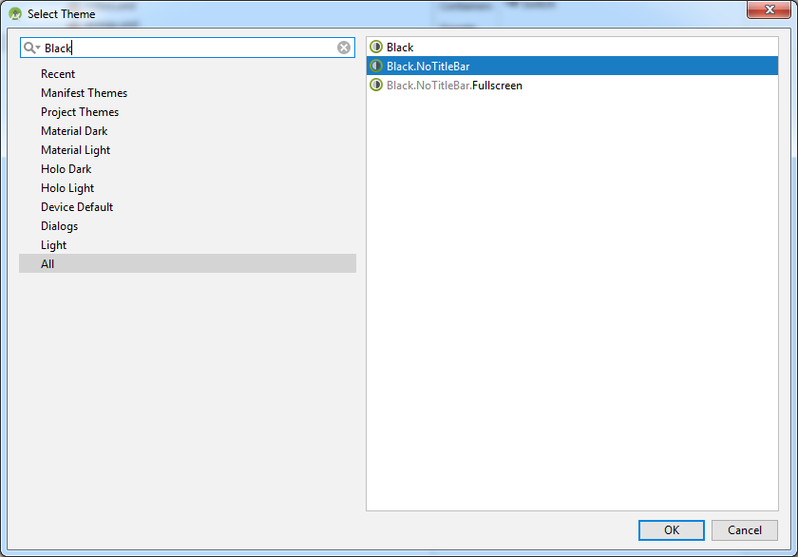
Click AppTheme button. In window that appears, type “Black” in the box at top left and select “Black.NoTitleBar”

Slide 5
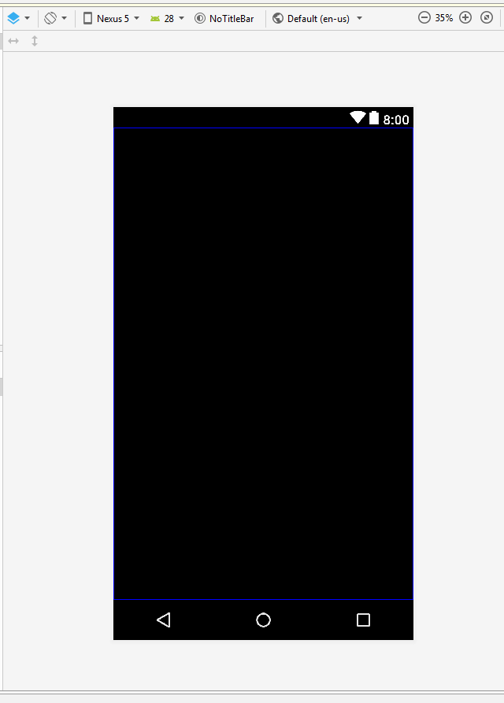
You get this:

Slide 6
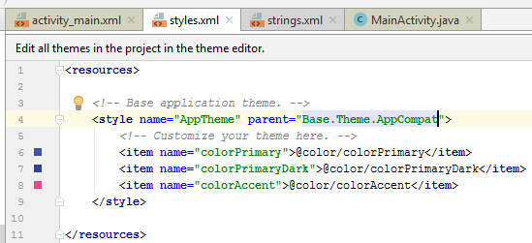
Now you need to update styles.xml. parent=“Base.Theme.AppCompat”

Slide 7
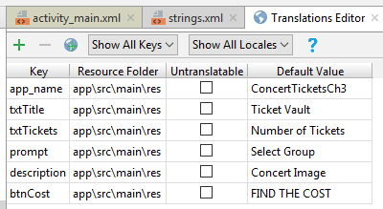
Add keys in Translations Editor
Open the Translations Editor
Add the keys in the table on the right:

Slide 8
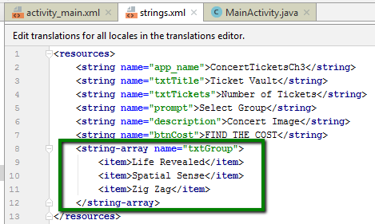
Add a string array to strings.xml
Used for controls that hold multiple text strings
Need to type xml tags
Start with <
End with >
Each element is inside <item></item> tags

Slide 9
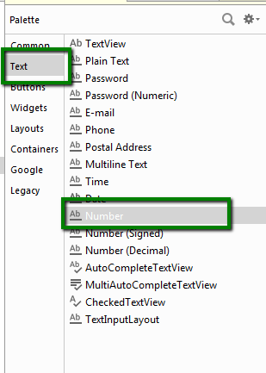
Add Text View and Number Text Field
TextView gets these Attributes:
ID: txtTitle
Text: @string/txtTitle
textSize: 48sp
Number Text Field gets these attributes:
ID: txtTickets
textSize: 36sp
hint: @string/txtTickets

Slide 10
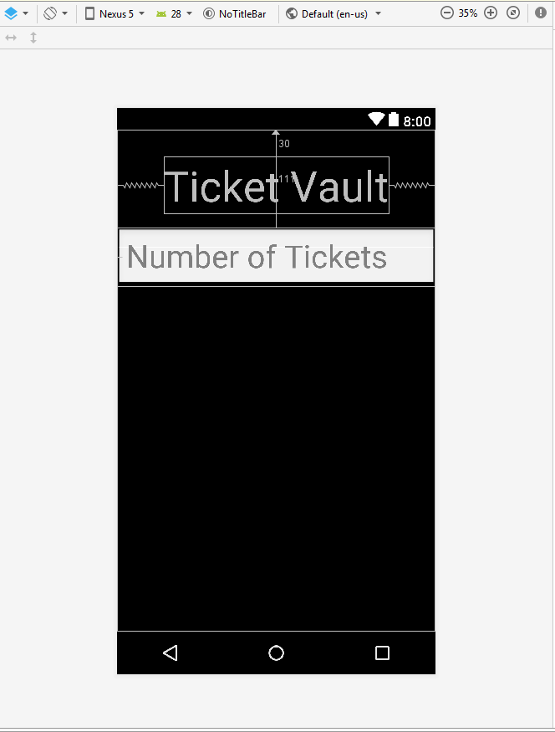
Now you have this:

Slide 11
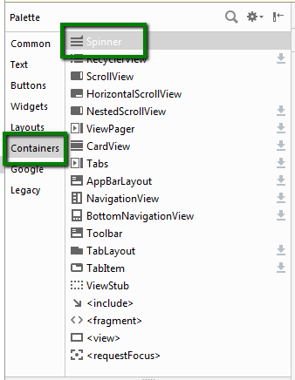
Add a Spinner widget
Acts like a drop-down menu
Found in Containers catgeory
Change the following attributes:
ID: txtGroup
prompt: @string/prompt
entries: @array/txtGroup

Slide 12
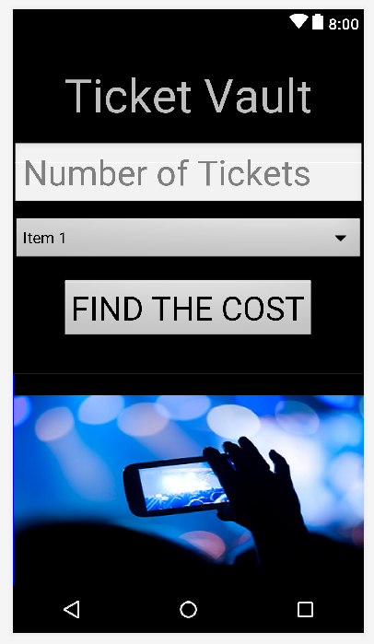
Add a Button, TextView and ImageView
Button attributes:
ID: btnCost
text: @string/btnCost
textSize: 34sp
TextView Attributes
ID: txtResult
textSize: 22sp
No text
ImageView Attributes:
First copy and paste “concert.png” into drawable folder
ID: imgConcert
srcCompat: @drawable/concert
contentDescription: @string/description

Slide 13
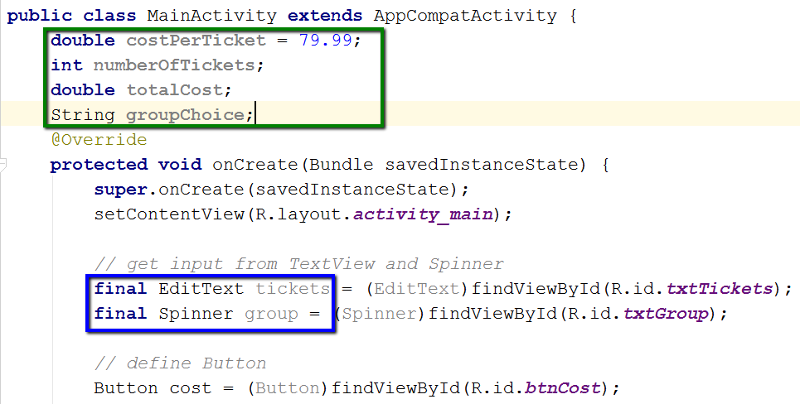
Start adding code to MainActivity.java
EditText class – extracts text from a TextView and converts it for use in Java.
Variables contain data that might change
Primitive types – int, double, boolean
Objects – String, EditText, Spinner
final – means a variable can only be initialized once and cannot be changed.

Slide 14
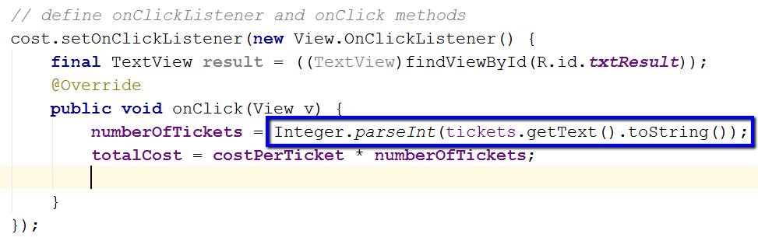
Now code setOnClickListener and OnClick
getText() – extracts text from a TextView (which is a String).
Integer.parseInt()
Converts text to integer so it can be used in calculations
Also have Double.parseDouble()
Math operations in Java
+ (addition)
- (subtraction)
* (multiplication)
/ (division)
% (remainder)

Slide 15
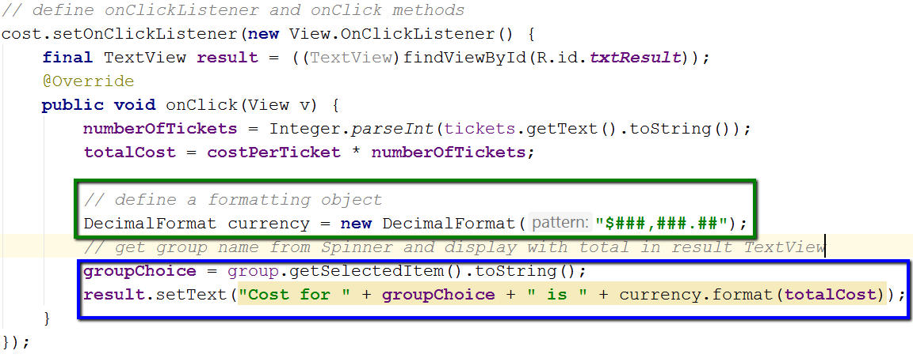
Add more code to onClick method
DecimalFormat class – formats number for output on Android device.
###,###.## means display a comma if more than 3 digits and rounds to two decimal places
getSelectedItem() method - returns current text from Spinner object
setText() method– displays text in a TextView control.
uses + for concatenation operator

Slide 16
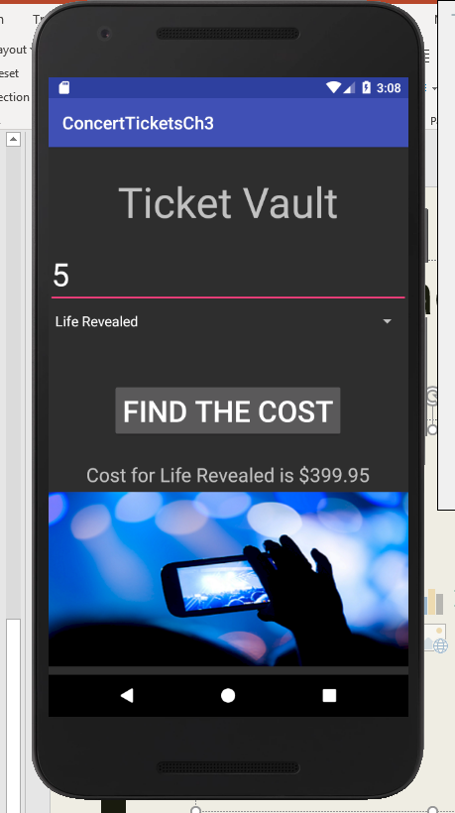
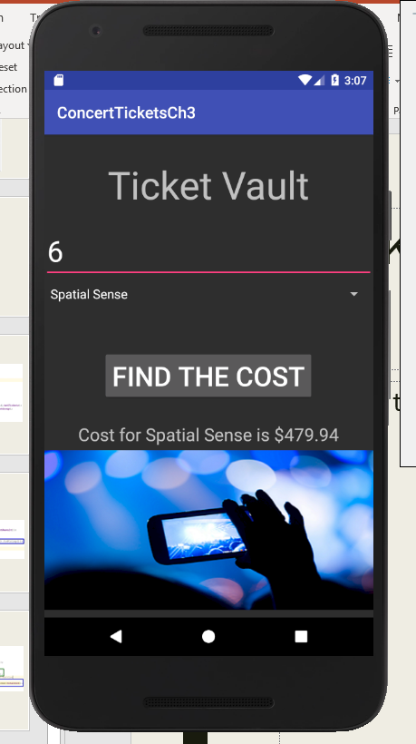
Output Samples

